Slide 1

CAP 6317/4773: Social Media Mining
Lecture 12: Data Mining
Raiyan Abdul Baten, Ph.D.
February 20, 2024

Slide 2
Recap

Slide 3

Does the choice of UI (Light vs Dark mode) affect usage duration?
Skeptical (Null) hypothesis: There is no difference in usage duration
Alternative hypothesis: There is a difference in usage duration
If the difference is significant, reject H₀
30
H₀: µ_{D} = µ_{L}
H_{a}: µ_{D} ≠ µ_{L}
µ_{D} and µ_{L} are the mean usage durations of the dark and light mode interfaces
20
Usage duration (min)
10
Dark mode
Light mode

Slide 4
Pro Tip 😉
If you’re not sure which hypothesis should be the skeptical default,
Write down the two hypothesis options
The option with the ‘=’ sign is always the null hypothesis
…why though?
Because we can never prove two things are equal. But with evidence, we can prove two things are NOT equal (and can reject H₀)
H₀: µ_{D} = µ_{L}
H_{a}: µ_{D} ≠ µ_{L}

Slide 5
Choosing the right statistical tests
Factors | Levels | Within/Between | Parametric Test | Non-parametric Test
1 | 2 | Between | Independent sample t-test | Mann-Whitney U test
1 | 2 | Within | Paired sample t-test | Kruskal-Wallis test
1 | >2 | Between | One-way ANOVA | Wilcoxon Signed-rank test
1 | >2 | Within | One-way Repeated Measures ANOVA | Friedman test
>1 | ≥ 2 | Between | Factorial ANOVA, Linear Model | Aligned Rank Transform (ART)
>1 | ≥ 2 | Within | Factorial Repeated Measures ANOVA, Generalized Linear Model | ART/ Generalized Linear Mixed Model

Slide 6
Choosing the right statistical tests
Factors | Levels | Within/Between | Parametric Test | Non-parametric Test
1 | 2 | Between | Independent sample t-test | Mann-Whitney U test
1 | 2 | Within | Paired sample t-test | Kruskal-Wallis test
1 | >2 | Between | One-way ANOVA | Wilcoxon Signed-rank test
1 | >2 | Within | One-way Repeated Measures ANOVA | Friedman test
>1 | ≥ 2 | Between | Factorial ANOVA, Linear Model | Aligned Rank Transform (ART)
>1 | ≥ 2 | Within | Factorial Repeated Measures ANOVA, Generalized Linear Model | ART/ Generalized Linear Mixed Model
A ‘factor’ is an independent variable that we’re varying across study conditions.

Slide 7
Choosing the right statistical tests
Factors | Levels | Within/Between | Parametric Test | Non-parametric Test
1 | 2 | Between | Independent sample t-test | Mann-Whitney U test
1 | 2 | Within | Paired sample t-test | Kruskal-Wallis test
1 | >2 | Between | One-way ANOVA | Wilcoxon Signed-rank test
1 | >2 | Within | One-way Repeated Measures ANOVA | Friedman test
>1 | ≥ 2 | Between | Factorial ANOVA, Linear Model | Aligned Rank Transform (ART)
>1 | ≥ 2 | Within | Factorial Repeated Measures ANOVA, Generalized Linear Model | ART/ Generalized Linear Mixed Model
A factor can take 2 or more ‘levels’

Slide 8
Factors and Levels
Factor: UI
Levels: Dark and Light
Dependent variable: usage duration
30
20
Usage duration (min)
10
How many bars in the plot
Dark mode
Light mode

Slide 9
Factors and Levels
Factor: Keyboard
Levels: iPhone, Pixel, Huawei
Dependent variable: Typing speed, number of errors
30
20
Typing speed (words/min)
10
iPhone
Pixel
Huawei

Slide 10
Choosing the right statistical tests
Factors | Levels | Within/Between | Parametric Test | Non-parametric Test
1 | 2 | Between | Independent sample t-test | Mann-Whitney U test
1 | 2 | Within | Paired sample t-test | Kruskal-Wallis test
1 | >2 | Between | One-way ANOVA | Wilcoxon Signed-rank test
1 | >2 | Within | One-way Repeated Measures ANOVA | Friedman test
>1 | ≥ 2 | Between | Factorial ANOVA, Linear Model | Aligned Rank Transform (ART)
>1 | ≥ 2 | Within | Factorial Repeated Measures ANOVA, Generalized Linear Model | ART/ Generalized Linear Mixed Model
Between: The conditions have independent participants
Within: The same participant belongs to multiple conditions

Slide 11

King Nebuchadnezzar’s Experiment
10 people in each team. Observe for 10 days. Declare winner by manual observation.
Factor: Food habit
Levels: Two
Within/Between: Between
Team Daniel
Kosher (Pulse and water)
Team Nebuchadnezzar
Non-Kosher (Meat and wine)

Slide 12
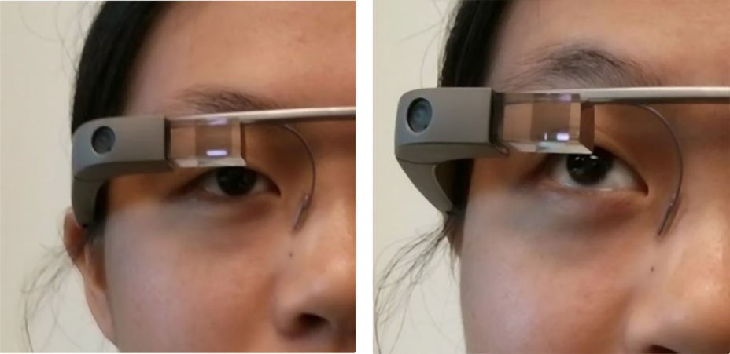

Slide 13
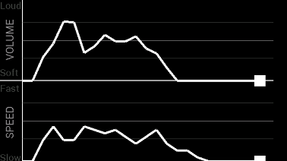
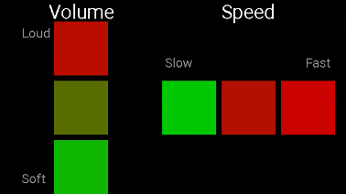
We want to test whether line plot feedback or bar plot feedback is more useful. We have 20 participants. Each participant tries both interfaces.
Factor: The UI
Levels: Two (line and bar plots)
Within/Between: Within

Slide 14
Choosing the right statistical tests
Factors | Levels | Within/Between | Parametric test name
1 | 2 | Between | Independent sample t-test
1 | 2 | Within | Paired sample t-test
1 | >2 | Between | One-way Anova
1 | >2 | Within | One-way Repeated Measures Anova

Slide 15
Reminder to self: Attendance

Slide 16
Hypothesis Testing

Slide 17
Choosing the right statistical tests
Factors | Levels | Within/Between | Parametric Test | Non-parametric Test
1 | 2 | Between | Independent sample t-test | Mann-Whitney U test
1 | 2 | Within | Paired sample t-test | Kruskal-Wallis test
1 | >2 | Between | One-way ANOVA | Wilcoxon Signed-rank test
1 | >2 | Within | One-way Repeated Measures ANOVA | Friedman test
Parametric test: Makes assumptions about the distribution of population from which the sample was taken
Non-parametric test: Makes no such assumption

Slide 18
Choosing the right statistical tests
Factors | Levels | Within/Between | Parametric Test | Non-parametric Test
1 | 2 | Between | Independent sample t-test | Mann-Whitney U test
1 | 2 | Within | Paired sample t-test | Kruskal-Wallis test
1 | >2 | Between | One-way ANOVA | Wilcoxon Signed-rank test
1 | >2 | Within | One-way Repeated Measures ANOVA | Friedman test
No need to test assumptions in non-parametric tests! Safer to use, reviewers give less pain. But it may be harder to find a significant p value when using nonparametric tests

Slide 19
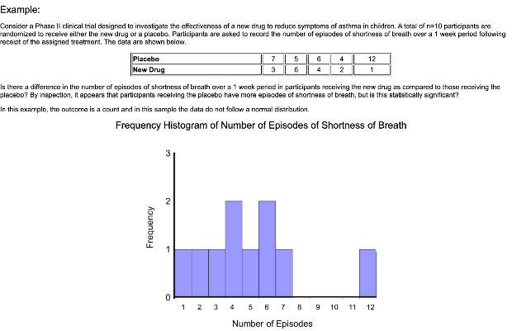
When do we choose nonparametric tests?
Data is skewed – doesn’t follow normal distribution (or any other distribution assumptions)
Pro tip: Count values typically do not follow the normal distribution

Slide 20
When do we choose nonparametric tests?
Data is skewed – doesn’t follow normal distribution (or any other distribution assumptions)
Pro tip: Count values typically do not follow the normal distribution
Sample size is too small

Slide 21
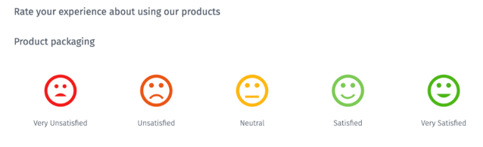
When do we choose nonparametric tests?
Data is skewed – doesn’t follow normal distribution (or any other distribution assumptions)
Pro tip: Count values typically do not follow the normal distribution
Sample size is too small
Data is ordinal or categorical
E.g.: Likert scale

Slide 22
Choosing the right statistical tests
Factors | Levels | Within/Between | Parametric Test | Non-parametric Test
1 | 2 | Between | Independent sample t-test | Mann-Whitney U test
1 | 2 | Within | Paired sample t-test | Kruskal-Wallis test
1 | >2 | Between | One-way ANOVA | Wilcoxon Signed-rank test
1 | >2 | Within | One-way Repeated Measures ANOVA | Friedman test

Slide 23
Choosing the right statistical tests
Factors | Levels | Within/Between | Parametric Test | Non-parametric Test
1 | 2 | Between | Independent sample t-test | Mann-Whitney U test
1 | 2 | Within | Paired sample t-test | Kruskal-Wallis test
1 | >2 | Between | One-way ANOVA | Wilcoxon Signed-rank test
1 | >2 | Within | One-way Repeated Measures ANOVA | Friedman test
>1 | ≥ 2 | Between | Factorial ANOVA, Linear Model | Aligned Rank Transform (ART)
>1 | ≥ 2 | Within | Factorial Repeated Measures ANOVA, Generalized Linear Model | ART/ Generalized Linear Mixed Model

Slide 24
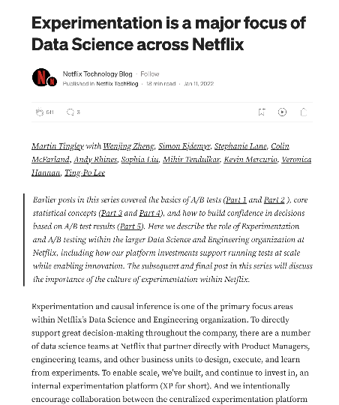

Slide 25
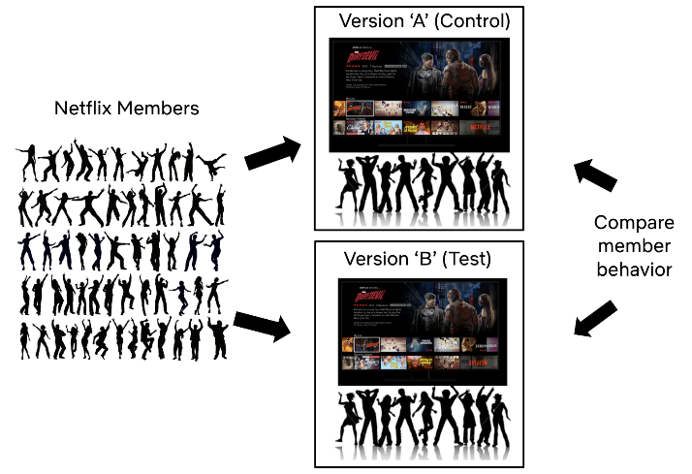
Source: https://netflixtechblog.com/experimentation-is-a-major-focus-of-data-science-across-netflix-f67923f8e985

Slide 26
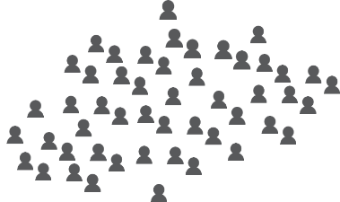
A/B testing on a social media platform
Condition A
Condition B

Slide 27
A/B testing on a social media platform
Condition A
Condition B
The recommendation engine is the independent variable (factor), it has two levels (A and B). We make observations of user behavior (dependent variable) in each condition

Slide 28
A/B testing on a social media platform
Age 25-40
Age 25-40
Age 18-25
Age 18-25
Age 40+
Age 40+
Condition A
Condition B
Add a second independent variable (factor): Age, with three levels (18-25, 25-40, 40+)

Slide 29
A/B testing on a social media platform
Age 25-40
Age 25-40
Age 18-25
Age 18-25
Age 40+
Age 40+
Condition A
Condition B
Add a second independent variable (factor): Age, with three levels (18-25, 25-40, 40+)
Now we have a 2x3 factorial design:
Recommendation engine (2 levels) x Age (3 levels)

Slide 30
Viewing duration
18-24
25-40
41+
18-24
25-40
41+
Condition A
Condition B

Slide 31
Choosing the right statistical tests
Factors | Levels | Within/Between | Parametric Test | Non-parametric Test
1 | 2 | Between | Independent sample t-test | Mann-Whitney U test
1 | 2 | Within | Paired sample t-test | Kruskal-Wallis test
1 | >2 | Between | One-way ANOVA | Wilcoxon Signed-rank test
1 | >2 | Within | One-way Repeated Measures ANOVA | Friedman test
>1 | ≥ 2 | Between | Factorial ANOVA, Linear Model | Aligned Rank Transform (ART)
>1 | ≥ 2 | Within | Factorial Repeated Measures ANOVA, Generalized Linear Model | ART/ Generalized Linear Mixed Model
One test to rule them all! Can even handle missing data, and any mixture of Within-Between subjects designs in different factors. First do omnibus, then do pairwise tests with corrections.

Slide 32


Quick Note on Randomized Controlled Experiments

Slide 33
Quick Note on Randomized Controlled Experiments
Key Intuition: Assign people to the different conditions randomly. Every observable characteristic (age, race, gender, education, health, income, etc) should then be similarly distributed across conditions (random assignment takes away the chance of any systematic difference). Any difference in the dependent variable of interest (e.g., vaccine efficacy) is then causally due to the one thing that was manipulated across conditions as an independent variable

Slide 34
Quick Note on Randomized Controlled Experiments
Age 25-40
Age 25-40
Age 18-25
Age 18-25
Age 40+
Age 40+
Condition A
Condition B
Age distribution should not be significantly different across the two conditions

Slide 35
Supervised and Unsupervised Learning

Slide 36
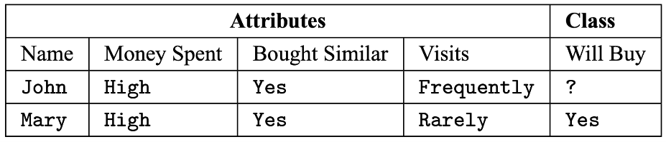
Supervised Learning
Regression: Target variable is continuous-valued
Classification: Target variable is discrete-valued

Slide 37
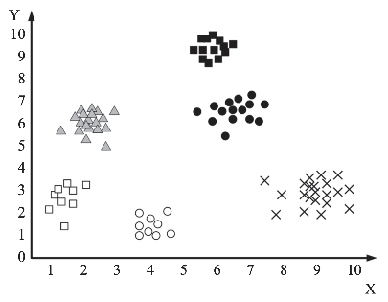
Unsupervised Learning
Clustering: No target variables mentioned, we need to figure it out from the features!

Slide 38
A closer look into data/feature types
Nominal/categorical
Names of things
Race
Marital status: Single, married, divorced, widowed
Hair color
Occupation
Chi-squared tests/mode can be meaningful

Slide 39

A closer look into data/feature types
Ordinal
Values have a meaningful order, but the magnitude between successive values is not specified
Likert Scale, drink size, professional rank
0: very dissatisfied, 1: somewhat dissatisfied, 2: neutral, 3: satisfied, 4: very satisfied
Small, medium, large
Assistant professor, Associate professor, Full professor
Non-parametric tests can be useful

Slide 40
A closer look into data/feature types
Numeric: (a) Interval
Intervals between units have an equal size
There is no true 0
Ratios don’t make any sense
Calendar dates, temperatures in Celcius/Fehrenheit scales
Year 0 doesn’t mean the beginning of time
0 degree Celsius doesn’t mean no temperature
6:16 PM is not the double of 3:08 PM

Slide 41
A closer look into data/feature types
Numeric: (b) Ratio
True 0 exists: Kelvin scale of temperature
Count values: years of experience, number of words
4 years is double the experience than 2 years
2000 words is double of 1000 words

Slide 42
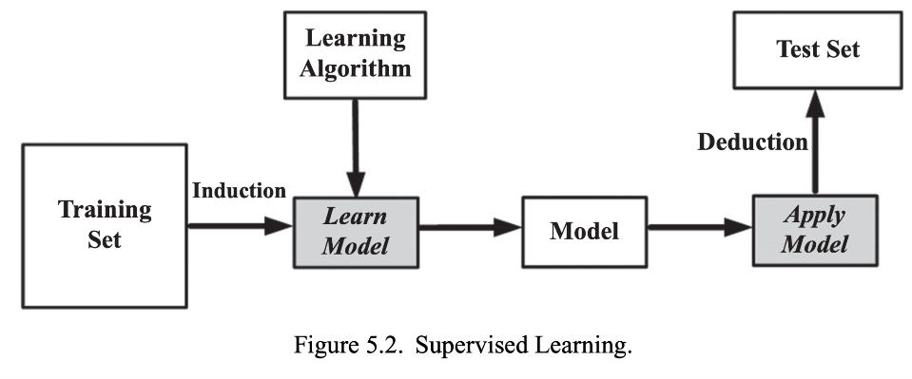

Slide 43
A Note on Machine Learning vs Econometrics
Typically, computer science applications focus more on future predictability/generalizability
Training, validation, test sets

Slide 44
A Note on Machine Learning vs Econometrics
Typically, computer science applications focus more on future predictability/generalizability
Training, validation, test sets
Econometrics applications focus more on causal explanations of prior data
Fit model on entire data!

Slide 45
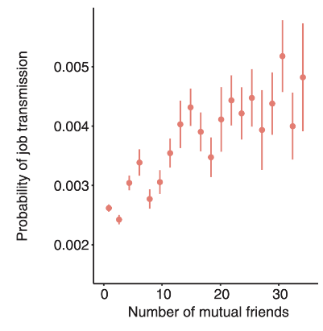


Strength of Weak Ties: LinkedIn
4 mutual friends
Strong ties appear to work better!

Slide 46
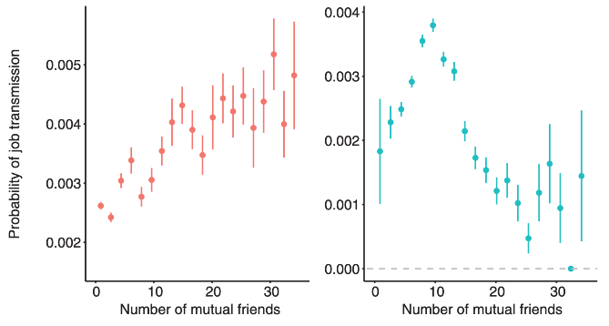
OLS
IV Regression
The strength of weak ties!
Rajkumar, Karthik, et al. "A causal test of the strength of weak ties." Science 377.6612 (2022): 1304-1310.

Slide 47
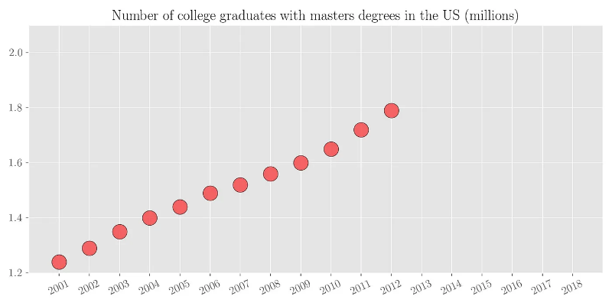
Regression Modeling

Slide 48
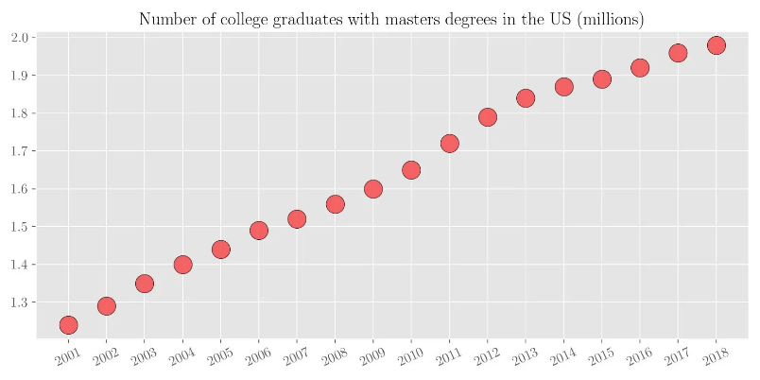
Regression Modeling

Slide 49
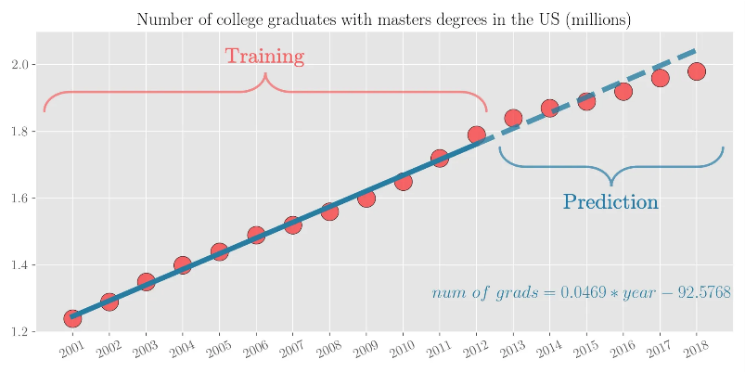
Regression Modeling

Slide 50
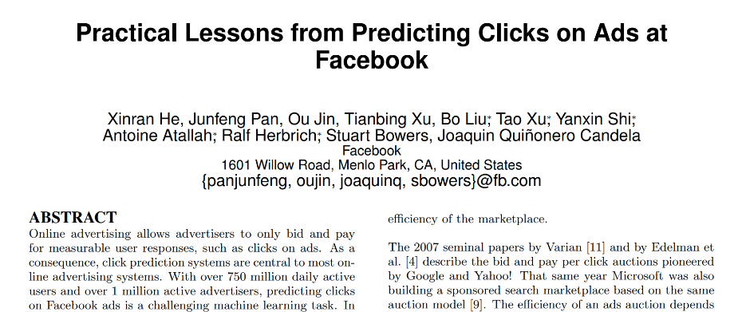

Slide 51
Regression Modeling
Linear regression – Ridge
Linear regression – LASSO
ElasticNet regression
Bayesian regression
Support Vector regression
Random Forest
AdaBoost
XGBoost

Slide 52
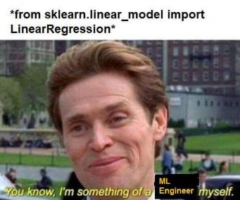
Regression Modeling
Linear regression – Ridge
Linear regression – LASSO
ElasticNet regression
Bayesian regression
Support Vector regression
Random Forest
AdaBoost
XGBoost
Scikit Learn is your best friend!

Slide 53
Data Preprocessing
Dealing with missing values

Slide 54
Data Preprocessing
Dealing with missing values
Ignore!
Fill in missing values manually
Use a global constant: ‘unknown’ or -inf
Use mean, median, or mode
Use mean, median, or mode from the same class
Use the most probable value using a learning algorithm

Slide 55
Data Preprocessing
Remove redundant features
Numeric data:

Slide 56
Data Preprocessing
Remove redundant features
Numeric data: Pearson’s correlation coefficient
If two features are highly and significantly correlated, they have redundant information

Slide 57
Data Preprocessing
Remove redundant features
Nominal/categorical data:

Slide 58
Data Preprocessing
Remove redundant features
Nominal/categorical data: Chi-squared test!

Slide 59
Data Preprocessing
Remove redundant features
Nominal/categorical data: Chi-squared test!
 | Male | Female | Total
Fiction | 250 | 200
Non-fiction | 50 | 1000
Total
If gender strongly implies fiction/non-fiction preference, then they have redundant information

Slide 60
Data Preprocessing
Remove redundant features
Nominal/categorical data: Chi-squared test!
 | Male | Female | Total
Fiction | 250 | 200 | 450
Non-fiction | 50 | 1000 | 1050
Total | 300 | 1200 | 1500
Take the total values…

Slide 61

Data Preprocessing
Remove redundant features
Nominal/categorical data: Chi-squared test!
 | Male | Female | Total
Fiction | 250 (90) | 200 (360) | 450
Non-fiction | 50 (210) | 1000 (840) | 1050
Total | 300 | 1200 | 1500
…and find expected frequencies based on the ratios of total data that fall into each class

Slide 62


Data Preprocessing
Remove redundant features
Nominal/categorical data: Chi-squared test!
 | Male | Female | Total
Fiction | 250 (90) | 200 (360) | 450
Non-fiction | 50 (210) | 1000 (840) | 1050
Total | 300 | 1200 | 1500

Slide 63
Data Preprocessing
Remove redundant features
Nominal/categorical data: Chi-squared test!
 | Male | Female | Total
Fiction | 250 (90) | 200 (360) | 450
Non-fiction | 50 (210) | 1000 (840) | 1050
Total | 300 | 1200 | 1500
Compare the Chi-square value against the Chi-square distribution table entry with degree of freedom (c-1)(r-1). If your value is greater than the reference value, you can reject the null hypothesis. Then, we would know that one feature implies the other–potentially indicating redundant information!

Slide 64
Data Preprocessing
Split into training, validation, and test sets
Typically 70 : 10 : 20
Can be 90 : 10 : 10 or 95 : 5 : 5 stricter if you have a lot of data
Random sampling vs stratified sampling

Slide 65
Data Preprocessing
Split into training, validation, and test sets
Typically 70 : 10 : 20
Can be 90 : 10 : 10 or 95 : 5 : 5 stricter if you have a lot of data
Random sampling vs stratified sampling
Warning: Beware of data leakage!
If a single user/participant/source contributes multiple data points, make sure that all of those data points are in the same training/validation/test set

Slide 66
Regression Modeling
Linear regression – Ridge
Linear regression – LASSO
ElasticNet regression
Bayesian regression
Support Vector regression
Random Forest
AdaBoost
XGBoost

Slide 67
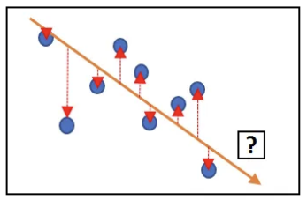

Simple Linear Regression
We want to learn w₀ and w₁. Consider the i-th data point,

Slide 68

Simple Linear Regression
We want to learn w₀ and w₁. Consider the i-th data point,
The residual sum of squares, RSS, is given by,

Slide 69

Simple Linear Regression
We want to learn w₀ and w₁. Consider the i-th data point,
The residual sum of squares, RSS, is given by,
We want to find w₀ and w₁ that minimize the RSS:

Slide 70
Simple Linear Regression
We want to find w₀ and w₁ that minimize the RSS:

Slide 71

Simple Linear Regression
We want to find w₀ and w₁ that minimize the RSS:
Taking the derivatives with respect to w₀ and w₁ :

Slide 72

Simple Linear Regression
We want to find w₀ and w₁ that minimize the RSS:
Taking the derivatives with respect to w₀ and w₁ :
To find the closed form solutions, set the gradients to 0:

Slide 73
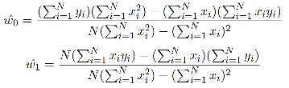
Simple Linear Regression
To find the closed form solutions, set the gradients to 0:

Slide 74
References
Figures stolen from
A Beginner’s Guide to Regression Analysis in Machine Learning, by Aqeel Anwar
Ridge & Lasso Regression by Deep Patel

Slide 75
Summary

